Slide 1
Chapter-One What Is Organizational Behavior
Md. Mostakin Arafat Riaz
Lecturer
Department of Business Administration
Sonargaon University

Slide 2
Organizational Behavior
Organizational behavior is a field of study that investigates the impact that individuals, groups, and structure have on behavior within organizations for the purpose of applying such knowledge toward improving an organization’s effectiveness.
OB is a field of study, meaning that it is a distinct area of expertise with a common body of knowledge. It focuses on three determinants of behavior in organizations: individuals, groups and the effect of structure on behavior in order to make organizations work more effectively.

Slide 3
Organizational Behavior
OB is concerned specifically with employment-related situations, it examines behavior in the context of job satisfaction, absenteeism, employee turnover, productivity, human performance, and management. Although debate exists about the relative importance of each, OB includes these core topics:
Motivation
Leader behavior and power
Interpersonal communication
Group structure and processes
Attitude development and perception
Change processes
Conflict and negotiation
Work design

Slide 4
Henry Mintzberg’s Managerial Roles
Henry Mintzberg, a well-known management researcher, studied actual manager at work. In his first comprehensive study, Mintzberg concluded that what managers do can best be described by looking at the managerial roles they engage in at work.
The term managerial roles refer to specific actions or behaviors expected of and exhibited by a manager.
Mintzberg’s pointed out three types of roles. These are-
Interpersonal roles
Informational roles
Decisional roles

Slide 5
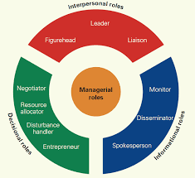
Mintzberg’s Managerial Roles

Slide 6
Mintzberg’s Managerial Roles
Interpersonal roles: One managerial category that Mintzberg described was interpersonal roles. Interpersonal roles of managers revolve around the specifics of working within a team and involve the behaviors associated with human interaction. These roles are important for maintaining order and communication within the company. The three interpersonal roles that Mintzberg described are the figurehead, the leader, and the liaison.
Figurehead: The figurehead role is one of ceremonial and symbolic duties. The manager in this role represents the organization to other groups, both inside and outside of the company. They may give speeches or presentations on behalf of the organization, attend events or meetings, and generally act as a public face for the company.

Slide 7
Mintzberg’s Managerial Roles
Leader: The leader role is all about motivating and guiding employees. The manager in this role sets goals for their team and provides support and direction to help them achieve these goals. They may also give performance reviews, provide feedback, and resolve conflicts.
Liaison: The liaison role involves maintaining communication between different groups within the organization. The manager in this role acts as a go-between for different departments or teams. They may relay messages, coordinate activities, and resolve conflicts.

Slide 8
Mintzberg’s Managerial Roles
Informational roles: The next managerial category Mintzberg described was informational roles. As the name suggests, informational roles of managers involve gathering and sharing information. The three informational roles that Mintzberg described are the monitor, the disseminator, and the spokesperson.
Monitor: The monitor role involves collecting information from internal and external sources. The manager in this role gathers data and keeps track of trends, both within the organization and in the wider industry. They may also conduct research and analysis to identify problems or opportunities.

Slide 9
Mintzberg’s Managerial Roles
Disseminator: The disseminator role is all about sharing information with others. The manager in this role distributes information to employees, other managers, and stakeholders. They may also act as a conduit for communication between different departments or teams.
Spokesperson: The spokesperson role is similar to disseminator role, but with a focus on external communication. The manager in this roles represents the organization to the media, shareholders and other external groups. They may give interviews, make speeches, or write articles.

Slide 10
Mintzberg’s Managerial Roles
Decisional roles: This category describes a manager's responsibility to use the information they gain to form business and strategic decisions. The managerial roles included in this category are entrepreneur, disturbance-handler, resource-allocator and negotiator.
Entrepreneur: The entrepreneur role involves responsibilities related to organizing and running business processes. These responsibilities may include solving problems and developing and implementing new ideas or strategies.
Disturbance-handler: When organization or team faces unexpected challenges, managers take the role of a disturbance handler to help manage the issue. These challenges can be both external or internal.

Slide 11
Mintzberg’s Managerial Roles
Resource allocator: In the resource allocator role, managers are responsible for managing and distributing resources. Managers make the decisions on how those materials will best be used or applied throughout the organization or team. These resources will vary, from funding to equipment to staff members.
Negotiator: In the negotiator role, managers participate in or direct negotiation situations. These negotiations may occur with external parties, where managers will represent the interests of their organization. Managers may also host negotiations with internal parties, such as other departments or their team members.

Slide 12
Management Skills
Another way to consider what managers do is to look at the skills or competencies they need to achieve their goals. Researchers have identified a number of skills that differentiate effective from ineffective managers. These are-
Technical skills
Human skills
Conceptual skills
Technical Skills: Technical skills encompass the ability to apply specialized knowledge or expertise. When one thinks of the skills of professional, one typically focus on the technical skills that they have learned through extensive formal education. All jobs require some specialized expertise, and many people develop their technical skills on the job.

Slide 13
Management Skills
Human Skills: The ability to understand, communicate with, motivate, and support other people, both individually and in groups, defines human skills. Many people may be technically proficient but poor listeners, unable to understand the needs of others, or weak at managing conflicts. Managers must have good human skills because they need to get things done through other people.
Conceptual Skills: Managers must have the mental ability to analyze and diagnose complex situations. These tasks require conceptual skills. Decision making, for instance, requires managers to identify problems, develop alternative solutions to correct those problems, evaluate those alternative solutions and select the best one. The abilities to integrate new ideas with existing processes and to innovate on the job are also crucial conceptual skills for today’s managers.

Slide 14
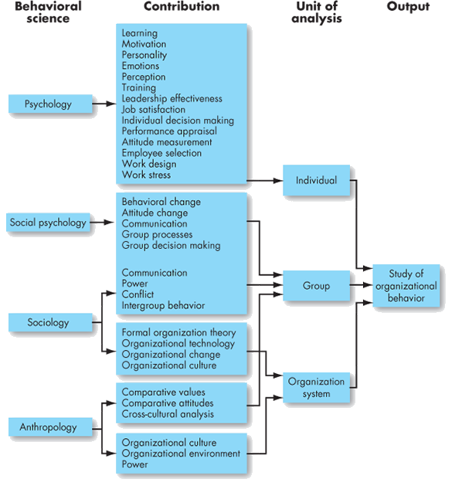
Disciplines That Contributes to OB

Slide 15
Disciplines That Contributes to OB
Psychology: Psychology seeks to measure, explain, and sometimes change the behavior of humans and other animals. Contributors to the knowledge of OB are learning theorists; personality theorists; counseling psychologists; and most important, industrial and organizational psychologists. More recently, their contributions have expanded to include learning, perception, personality, emotions, training, leadership effectiveness, needs and motivational forces, job satisfaction, decision-making processes, performance appraisal, attitude measurement, employee selection techniques, work design, and job stress.
Social Psychology: Social psychology, generally considered a branch of psychology , blends concept from both psychology and sociology to focus on people’s influence on one another. One major study area is change- how to implement it and how to reduce barriers to its acceptance.

Slide 16
Disciplines That Contributes to OB
Sociology: While psychology focuses on the individual, sociology studies people in relation to their social environment or culture. Sociologists have contributed to OB through their study of group behaviors in organizations, particularly formal and complex organization. Perhaps most important, sociologists have studied organizational culture, formal organizational theory and structure, organizational technology, communications, power, and conflicts.
Anthropology: Anthropology is the study of societies to learn about human beings and their activities. Anthropologists’ work on cultures and environments has helped us understand differences in fundamental values, attitudes, and behavior among people in different countries and within different organizations.

Slide 17
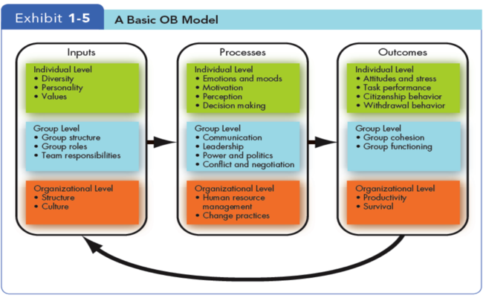
Developing an OB Model
A model is an abstraction of reality, a simplified representation of some real world phenomenon. OB model proposes three types of variables (inputs, processes, and outcomes)at three level of analysis (individual, group, and organizational).

Slide 18
Developing an OB Model (Input)
Inputs are variables like personality, group structure, and organizational culture that lead to processes. These variables set the stage for what will occur in an organization later. Many are determined in advance of the employment relationship.
For example, individual diversity characteristics, personality, and values are shaped by a combination of an individual’s generic inheritance and childhood environment.
Group structure, roles, and team responsibilities are typically assigned immediately before or after a group is formed.
Organizational structure and culture are usually the results of year of development and change as the organization adapts to its environment and builds up customs and norms.

Slide 19
Developing an OB Model (Processes)
If inputs are like the nouns in OB, processes are like the verbs. Processes are actions that individuals, groups, and organizations engage in as a result of inputs and that lead to certain outcomes.
At the individual level, processes include emotions and moods, motivation, perception, and decision making.
At the group level, they include communication, leadership, power and politics, and conflict and negotiation.
At the organizational level, processes include human resources management and change practices.

Slide 20
Developing an OB Model (Outcomes)
Outcomes are the key variables that one want to explain or predict and that are affected by other variables. Scholars have emphasized individual-level outcomes, such as attitudes and stress, task performance, citizenship behavior, and withdrawal behavior.
At the group level, cohesion and functioning are the dependent variables.
At the organizational level, we look at overall productivity and survival.

Slide 21
Developing an OB Model (Outcomes)
Attitudes and Stress: Employee attitudes are the evaluations that employees make, ranging from positive to negative, about objects, people, or events. Stress is a psychological process that occurs in response to environmental pressures.
Task Performance: The combination of effectiveness and efficiency at doing core job tasks is a reflection of one’s level task performance. If we think about the job of a factory worker, task performance could be measured by the number and quality of products produced in an hour.
Organizational Citizenship Behavior: The discretionary behavior that is not part of an employee’s formal job requirements, and that contributes to the psychological and social environment of the workplace, is called organizational citizenship behavior or simply citizenship behavior.

Slide 22
Developing an OB Model (Outcomes)
Withdrawal Behavior: Withdrawal behavior is the set of actions that employees take to separate themselves from the organization. There are many forms of withdrawal, ranging from showing up late or failing to attend meetings to absenteeism and turnover.
Group Cohesion: Group cohesion is the extent to which members of a group support and validate one another at work.
Group Functioning: Group functioning refers to the quantity and quality of a group’s work output.

Slide 23
Developing an OB Model (Outcomes)
Productivity: The highest level of analysis in OB is the organization as a whole. An organization is productive if it achieves its goals by transforming inputs into outputs at the lowest cost. Thus, productivity requires both effectiveness and efficiency.
Survival: The final outcome we will consider is organizational survival, which is simply evidence that the organization is able to exist and grow over the long term. The survival of an organization depends not just on how productive the organization is but also on how well it fits with environment.

Slide 24
END OF CHAPTER
HAVE A GOOD DAY………

